Slide 1

DATA MANAGEMENT AND STORAGE IN THE CLOUD
By,
Inchara S
4VV22IS041

Slide 2

What is Cloud Data Storage?
Cloud data storage refers to storing digital data on remote servers accessed over the internet, rather than on a local computer or hard drive.
It allows users to store, access, and manage data from anywhere with an internet connection. Cloud storage providers manage the infrastructure, security, and accessibility of the data.

Slide 3
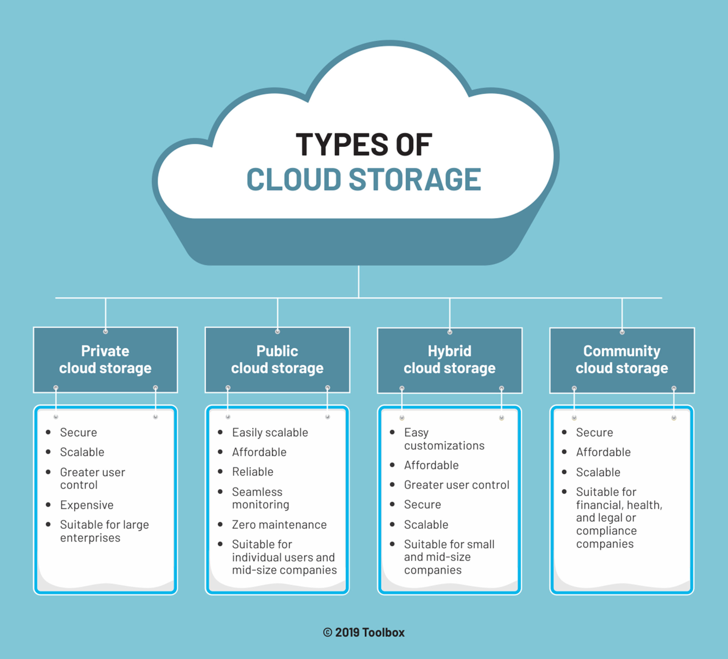
Types of Cloud Data Storage

Slide 4
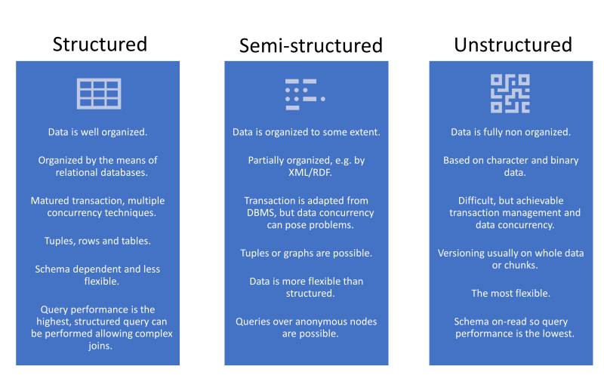
Main Ways In Which Data Is Stored

Slide 5
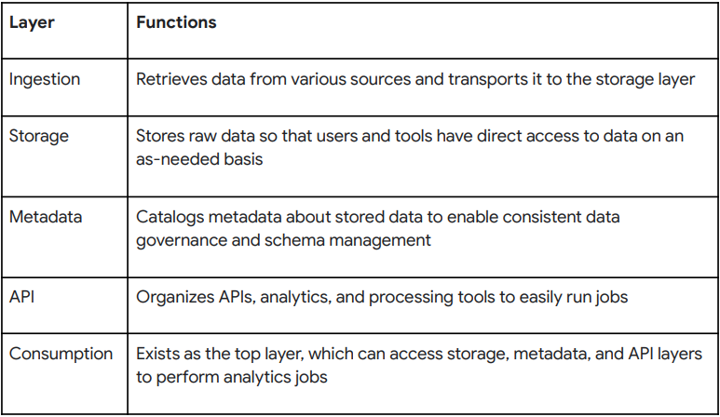

Data Lakehouse
A data lakehouse is a data architecture that blends a data lake and data warehouse together. Data lakehouses enable machine learning, business intelligence, and predictive analytics, allowing organizations to leverage low-cost, flexible storage for all types of data — structured, unstructured, and semi-structured — while providing data structures and data management features.
Components of Data Lakehouse Architecture

Slide 6
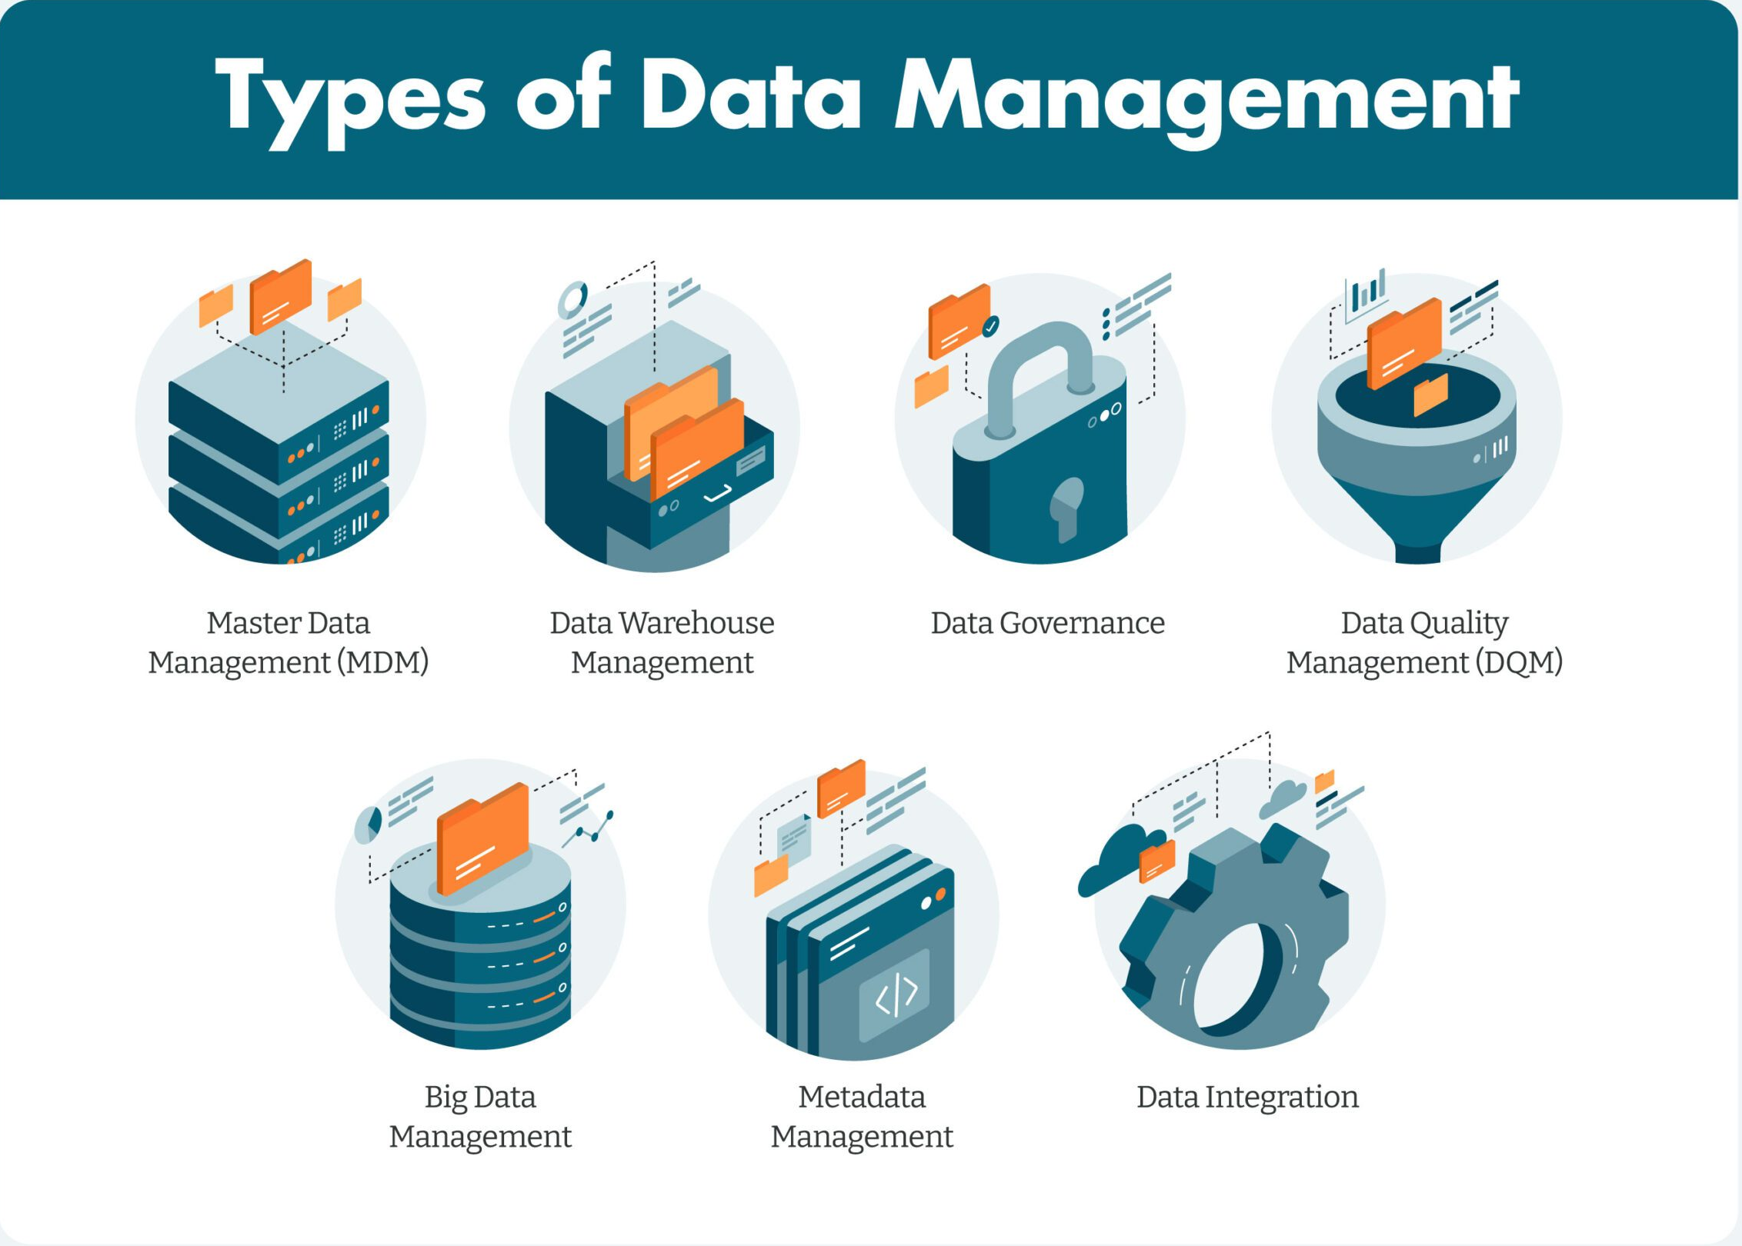
Data Management
Cloud data management is a way of managing all data that an enterprise has stored, either in the cloud—or multiple clouds—or on-premises using a cloud-based solution.
An effective cloud-based data management solution can have the same capabilities as a modern on-prem data management solution such as data backup, disaster recovery, archiving, file and object services, and analytics. Some data management in cloud vendors even offer protection against ransomware.

Slide 7
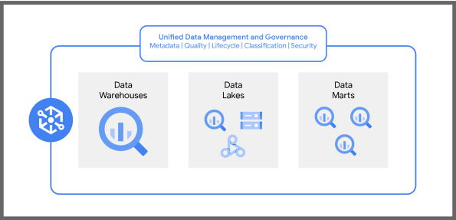
The Dataplex Architecture
As a data fabric, Dataplex provides centralized data access and security controls. This means that all the data in an organization falls under the same governance and rules. Dataplex brings together various data sources and services.

Slide 8

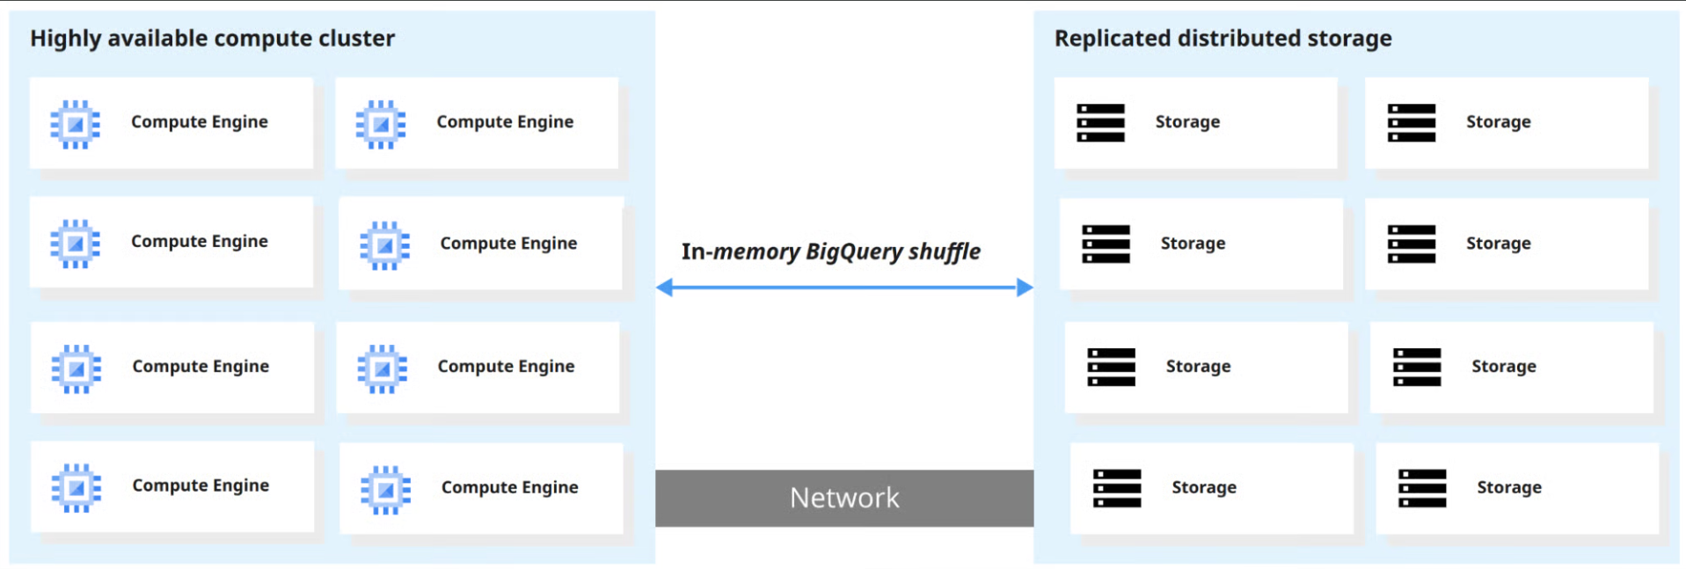
BigQuery
BigQuery is a fully managed data warehouse developed by Google that helps manage and analyze data. The tool’s serverless architecture enables organizations to get insights into their business and answer questions quickly.
BigQuery’s scalable and distributed analytical engine also lets users query petabytes of data using SQL.
How Does BigQuery Work?

Slide 9

Thank You :)

